Slide 1

COMM 3590
Week 6
Unit 4:
Analyzing the Job Ad & Researching a Company

Slide 2
Pre-
interview
Job Ad Analysis & Research
Interview
Interview Performance
Post- Interview
Accepting Offer
Resume
Cover Letter
Follow-up

Slide 3

the largest ONLINE professional network
for anyone who is looking to advance their career
Uses:
find the right job or internship
connect and strengthen professional relationships
learn the skills you need to succeed
How to get Started:
Create a Profile
Build Network (Follow/ Add/ Connect)
Find a Job
Participate
Network= Net Worth
https://www.linkedin.com/help/linkedin/answer/111663/what-is-linkedin-and-how-can-i-use-it-?lang=en

Slide 4
Tips in Using Linkedin
https://www.linkedin.com/business/sales/blog/profile-best-practices/17-steps-to-a-better-linkedin-profile-in-2017
https://www.wordstream.com/blog/ws/2014/09/09/improve-linkedin-profile
https://resumelab.com/career-advice/linkedin-tips
https://www.linkedinsights.com/5-stunningly-good-graduate-student-linkedin-summary-examples/
Pay attention to every single details, even your email address

Slide 5
Job Search Websites
LOCAl/national
international
www.chinahr.com
www.zhipin.com
https://www.51job.com
https://wz.58.com/
Zhaopin.com
https://www.chinajob.com/
www.indeed.com
www.monster.com
www.glassdoor.com
www.higheredjobs.com
www.careerbuilder.com
By region or Country?
Privacy Policy

Slide 6
Analysing a Job Ad
Select a few job websites that fit your needs.
Start searching with ‘Keywords’ (marketing, entry, trainee)
2. Review company + look for company’s basic information
Services, competitors, recent projects, reputation, division
https://malaysia.indeed.com/jobs?q=trainee&l&advn=759550964111416&vjk=4df4694a1efcad08

Slide 7
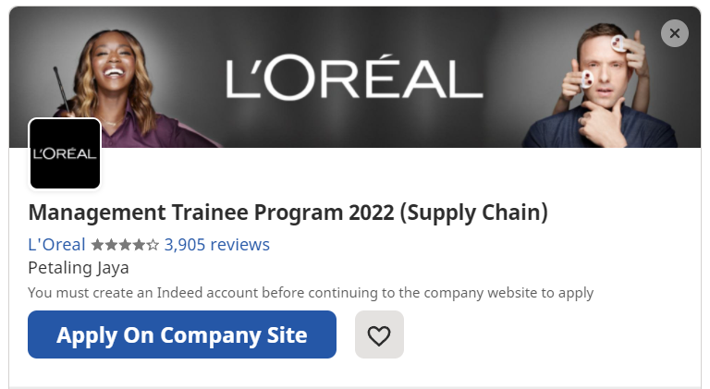
Analysing a Job Ad
https://malaysia.indeed.com/jobs?q=trainee&l&advn=759550964111416&vjk=4df4694a1efcad08

Slide 8


Slide 9
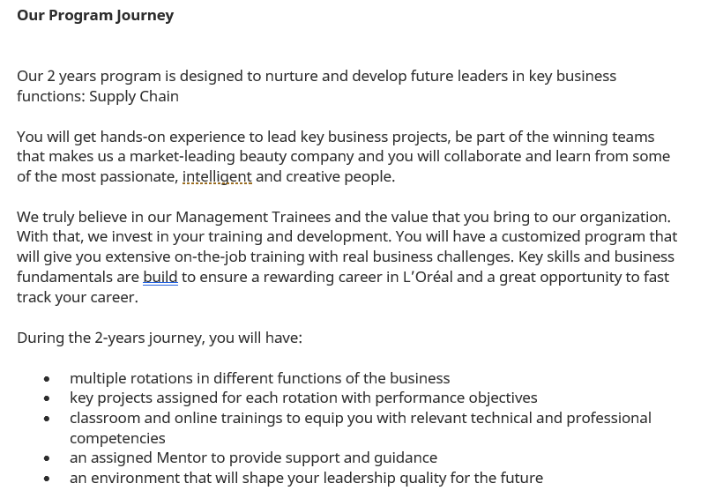

Slide 10
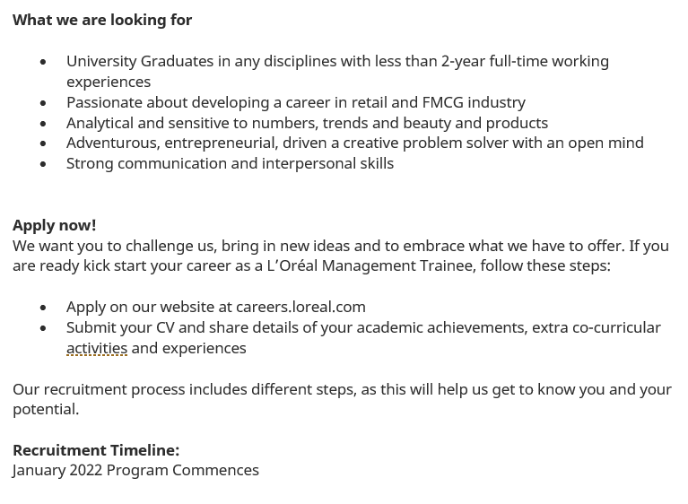

Slide 11
Analysing a Job Ad
Click To Apply HERE
https://malaysia.indeed.com/jobs?q=trainee&l&advn=759550964111416&vjk=4df4694a1efcad08

Slide 12
Questions:
Do you have an EXISTING resume + cover letter?
If you were to apply for this position, do you think the traits/ information listed in your EXISTING documents are sufficient to get you an interview opportunity?
How are you going to improve both of the documents to make you stand out from other applicants?

Slide 13
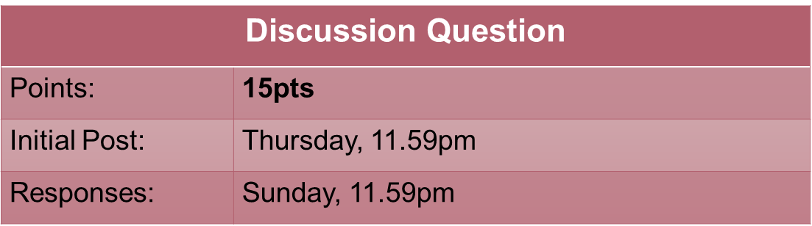
Homework (DQ6)
Identify 2 job search websites.
Compare 3 criteria of both websites (feature, function, variety….) in a table.
If you were to recommend one to a fresh graduate who’s looking for an entry-level job, which one will you choose? Justify your answers based on your research.

Slide 14
EXAMPLE:
 | Website 1 | Website 2
Criterion 1
Criterion 2
Criterion 3
Recommendation

Slide 15
Homework (AS6)
Discussion Question
Points: | 30pts
Deadline: | 19 October 2021 (Tuesday), 11.59pm

